Slide 1
ACF Model in Python
Pauline Dang

Slide 2
This week I…
Worked with numpy, pandas, and statsmodels to make an autocorrelation model in python
Worked with pandas functions to read data
Made visuals

Slide 3
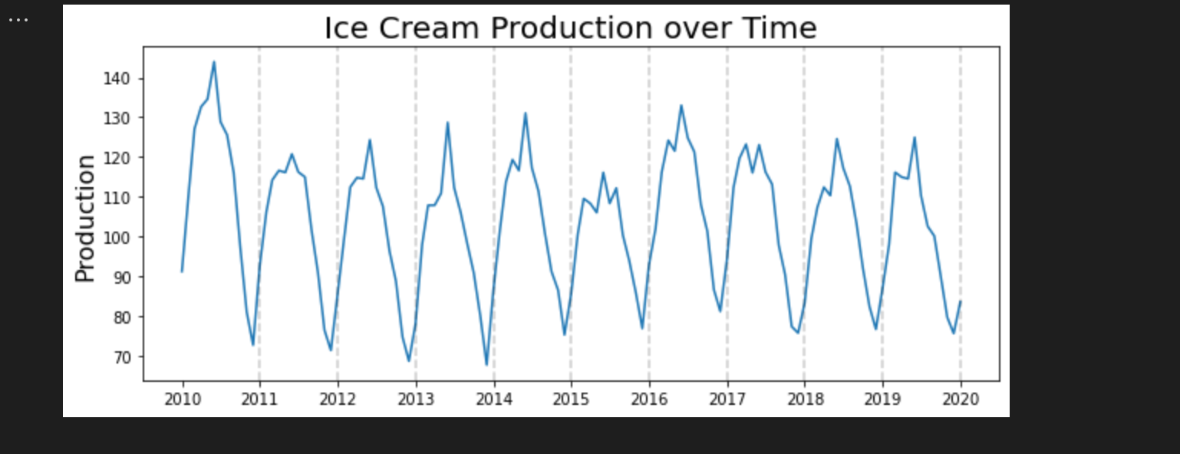
Observations
This data is not stationary as it displays seasonality, with a peak in the middle of the year.

Slide 4
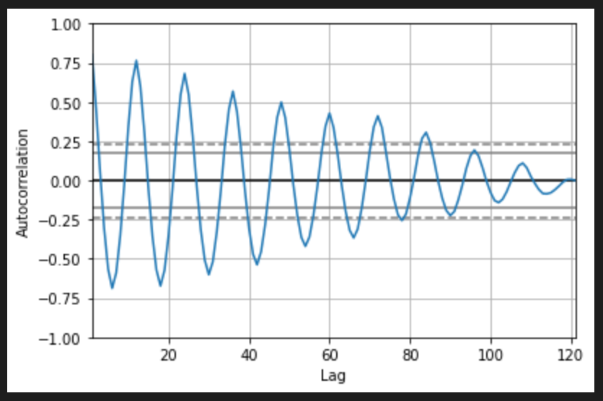

Slide 5
Questions I Have
How do I determine the number of lags I should use?

